Slide 1
To complain or not to complain?
Analysis by Faith Forde
September 2026
A 3-year analysis of NYC DOHMH’s response to 311 complaints for Food Service Establishment

Slide 2
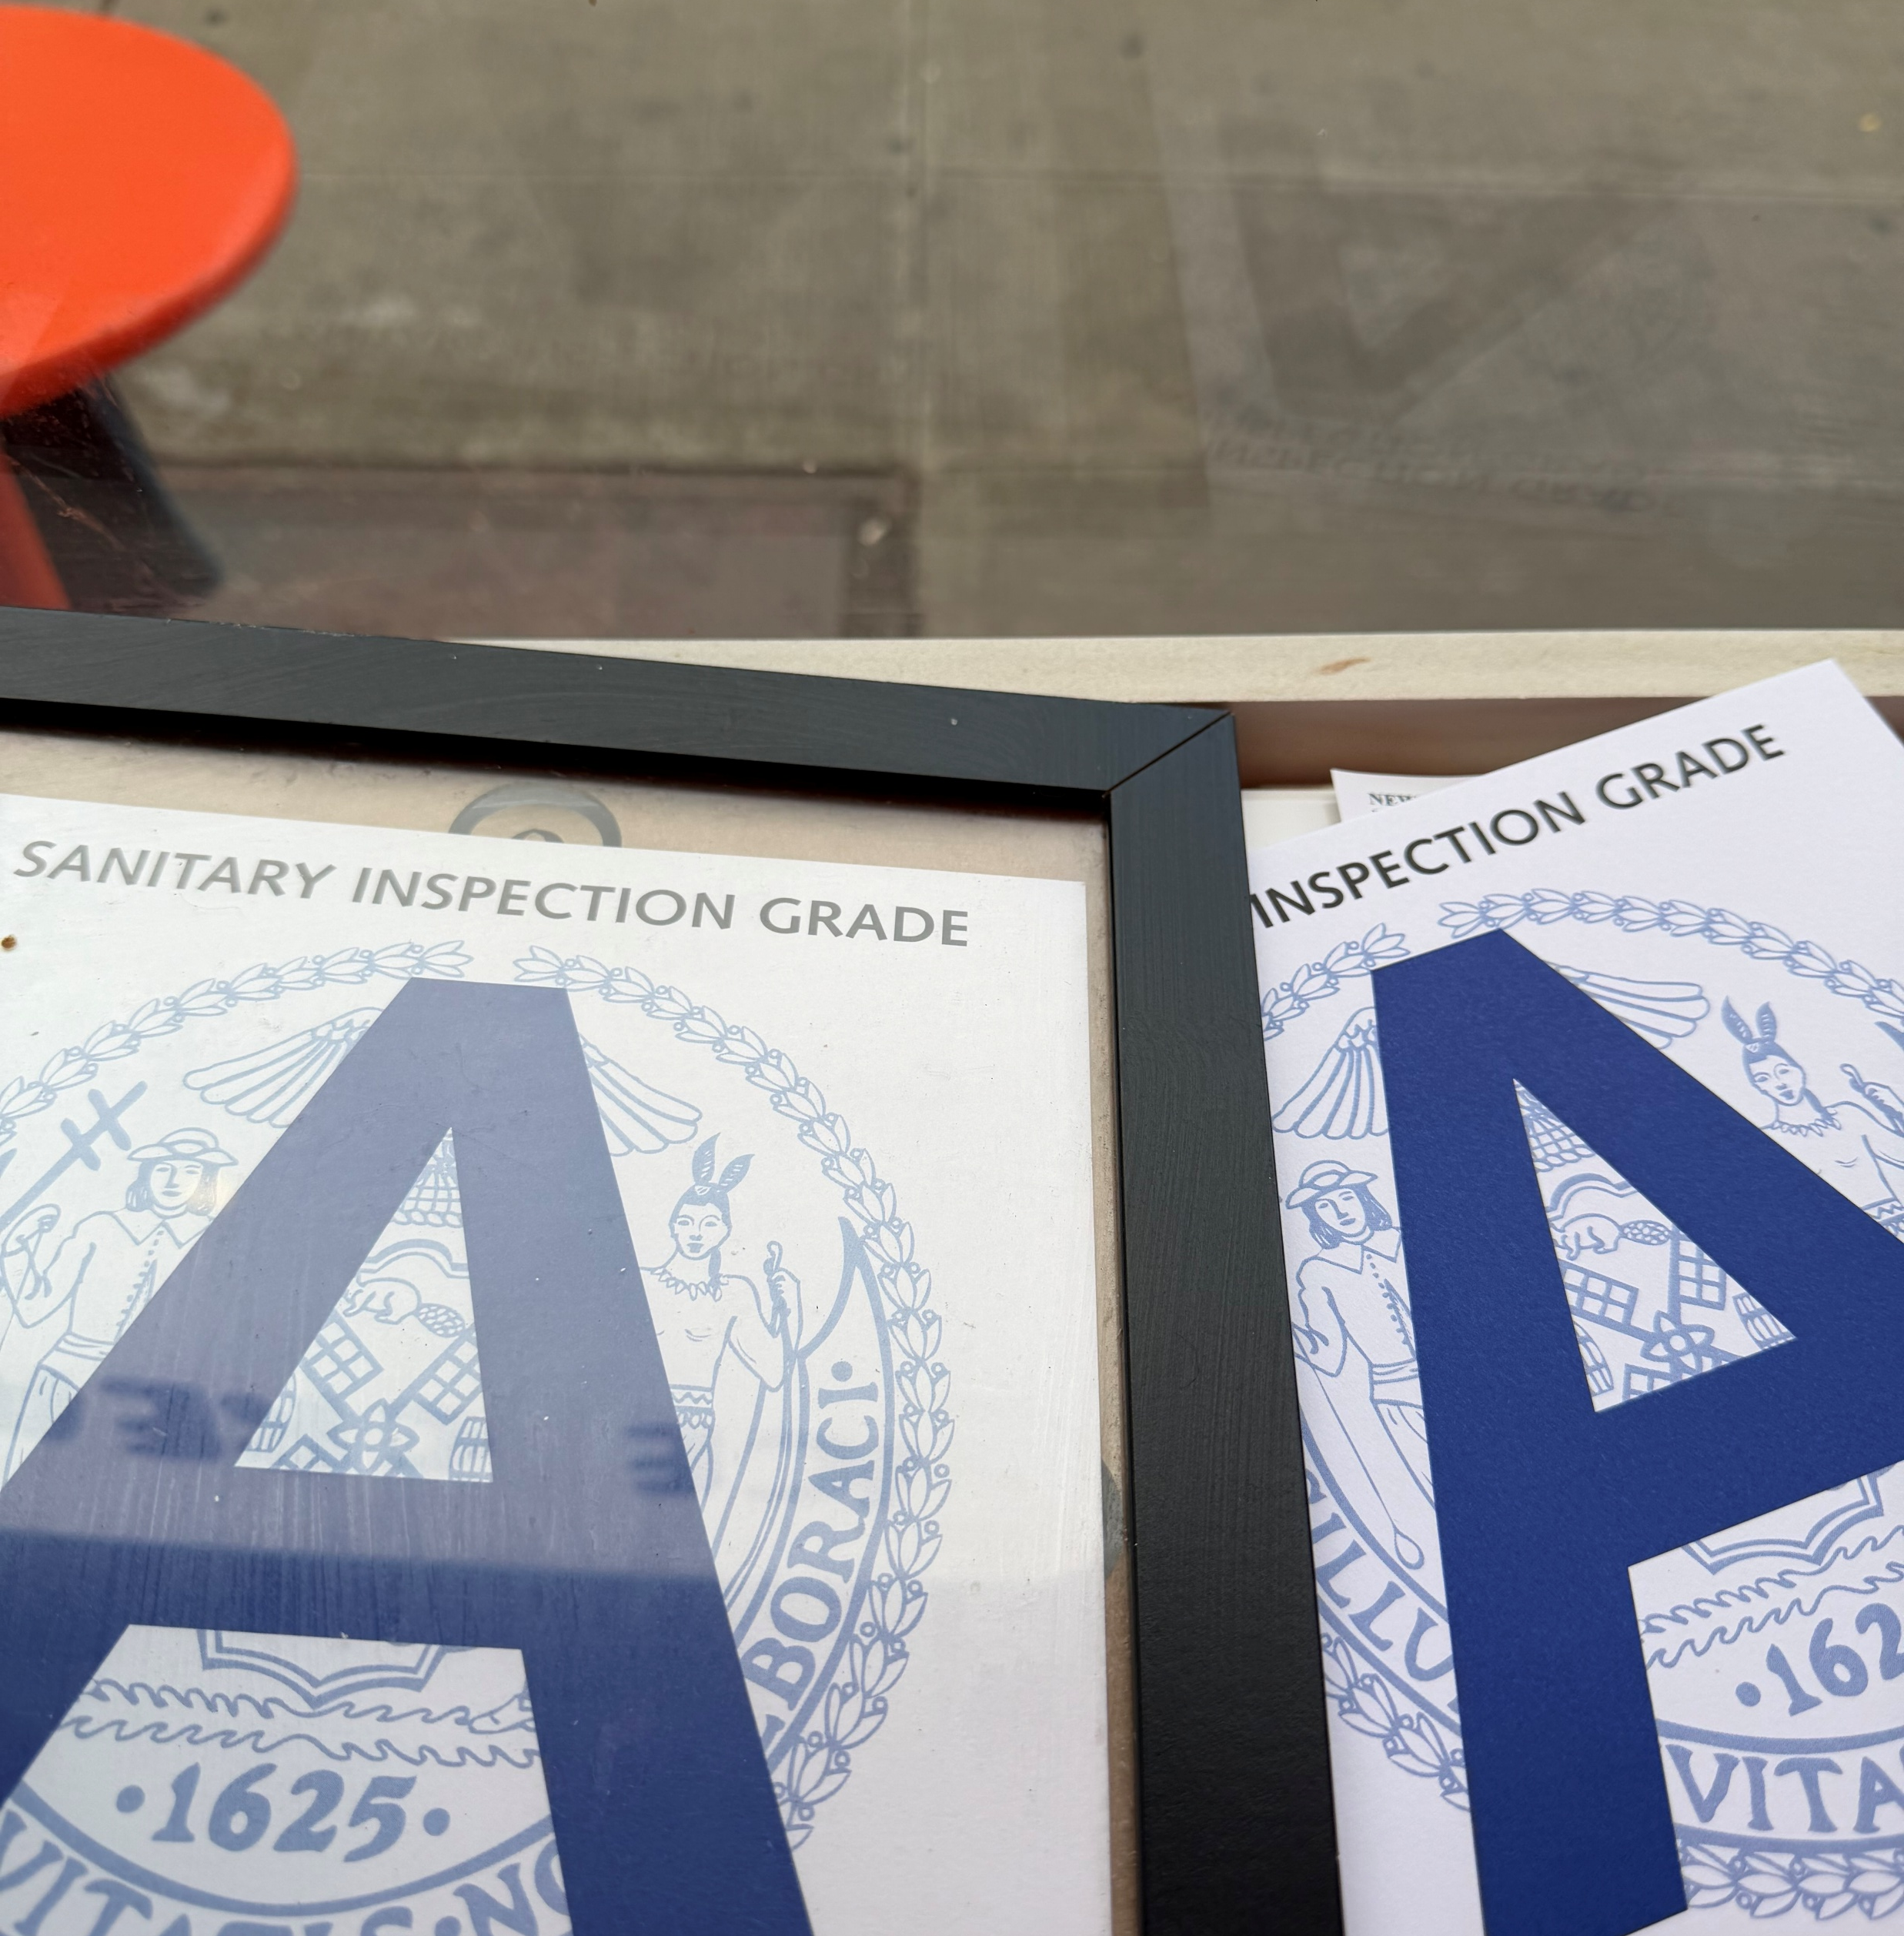

Welcome
I work as a Health (Restaurant) Inspector at NYC Department of Health & Mental Hygiene
in the complaints unit (responding to 311 complaints related to food service establishments and tattoos)
DISCLAIMER: This project represents all of my own original thoughts and not those of my department or agency
A 311 Service Request is a customer request for a City Agency’s attention and response to a particular condition or situation (1)
This database shows where the complaints unit work assignments are sourced.
The analysis show how well the complaints unit is responding
I conclude with ways to improve the response to the complaints

Slide 3
Introduction
Goal – Analyze the New York City Department of Health and Mental Hygiene Bureau of Food Safety and Community Sanitation Complaints Unit response to 311 service requests over the last 3 years.
Data Source: NYC Open Data — “311 Service Requests from 2020 to Present” (1)
  Study period: January 1, 2023–August 31, 2026
  Scope: DOHMH requests involving food service establishments
  Project involves Pandas, mathplotlib.pyplot, plotly.express
    dtypes conversion, subset dataframe with limited columns, groupby, .plot, .px.treemap, normalize, head(20) , drop columns
Notes:
Also responds to tattoo parlours, poison ivy, heat.

Slide 4
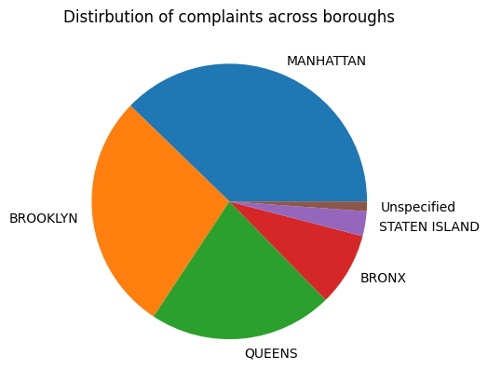
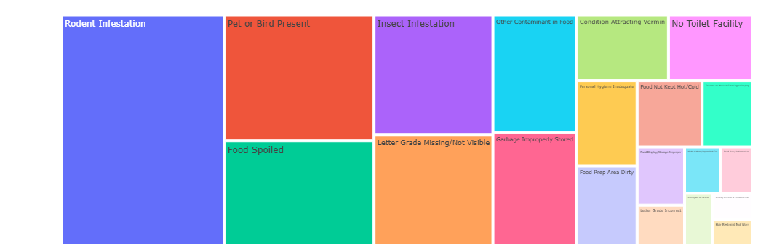
complaints from January 1, 2023 – August 31st, 2026
39 complaints per day
2 per (24)hour
(5 per workday)
52,082
Top 20 complaints
Notes:
52083 rows × 44 columns

Slide 5
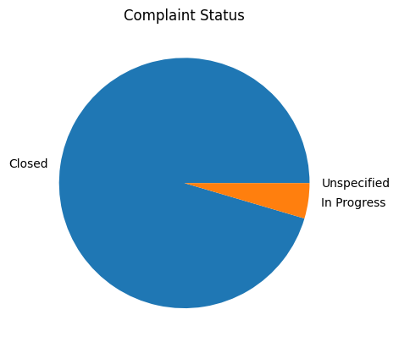
Department’s top 5 responses when closing complaints
The NYC Health Department has responded to your service request. Restaurant inspection information can be found online at www.nyc.gov/health/abceats. This service request has been closed. (26,984)
This SR was administratively closed. The issue you reported was addressed. (13,378)
The Department of Health and Mental Hygiene has determined that the reported incident is isolated. The establishment will be inspected according to its normal schedule for sanitary inspections. (5,464)
The Department of Health and Mental Hygiene has sent official written notification to the Owner/Landlord warning them of potential violations and instructing them to correct the situation. If the situation persists 21 days after your initial complaint, please make a new complaint (1987)
The Department of Health and Mental Hygiene has sent official written notification to the Owner/Landlord warning them of potential violations and instructing them to correct the situation. If the situation persists 21 days after your initial complaint, please make a new complaint. (1471)
Notes:
4.5 in progress
Not necessarily not investigated, just not closed administratively
Resolutions are repetive and ambiguous – hard to analyze

Slide 6
How do we measure performance?
The Service Level Agreement (SLA) is a period of time defined by the receiving Agency in order to provide the customer with the expected time until an update or final resolution of 311 service request. (2)
This represents the time the agency projects for their initial response to a specific type of problem.
  n.b This can the time for first response and not necessarily the final resolution of the problem.
3 days – Ill food worker, contaminated facility/equipment, water served contaminated, no running water
21 days – Food Contaminated with Cannabis, CBD or THC
37 days – everything else
as of March, 2024 (2)
Notes:
SLA Last updated March 5, 2024

Slide 7
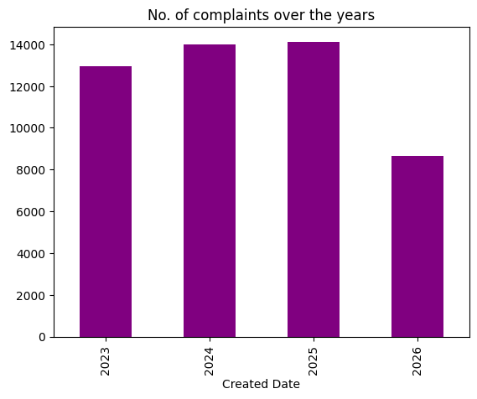
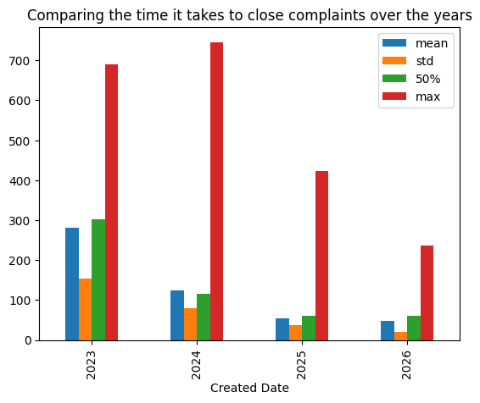
How is the Department doing?
Created Date | count | mean | std | median | max
2023 | 12,934 | 282 | 155 | 302 | 689
2024 | 13,986 | 124 | 80 | 117 | 746
2025 | 14,131 | 55 | 38 | 60 | 422
2026 | 8,655 | 48 | 21 | 60 | 237
Number of days to close a complaint, by year
Notes:
No number of complaints increasing and response time deceasing

Slide 8
Summary
5 complaints per work hour per day - Number trending upwards with a steady increase
Department is getting faster at closing service requests (closing) year by year
Resolution are ambiguous and hard to analyze
Next steps /studies
  Find busy complaint months and the department can plan work schedules better to ensure fast responses
  Clearly define the resolutions
  Communicate with the public what is allowed or not

Slide 9
To complain or not to complain?
  YES!
  you are being heard and answered!

Slide 10


“If you complain to someone, you assume that it's someone who really cares about you.” – Scott Hahn
By responding to complaints, albeit in a timely manner, NYC DOHMH informs New Yorkers that the 311 complaints portal is a safe space to report unsanitary food establishment conditions and the confidence to continue to dine at these restaurants.

Slide 11
References
https://opendata.cityofnewyork.us/311-service-requests-from-2010-to-present-updates/
311 Service Level Agreements | NYC Open Data
AI programs such as Gemini and ChatGPT were used to clarify some codes used in Python during the analysis

